Slide 1
SECURE DATA HIDING IN IMAGES USING STEGANOGRAPHY
CAPSTONE PROJECT
Presented By:
Student Name : Markandey Shukla
College Name & Department : Microtek College of Management And Technology, BCA Department

Slide 2
OUTLINE
Problem Statement
Technology used
Wow factor
End users
Result
Conclusion
Git-hub Link
Future scope

Slide 3
Problem Statement
Of course! At first, the password that was saved during encryption could not be accessed after decryption. When it was embedded in the image, it became difficult to tell the password from the message. We built a distinct password file to address this, guaranteeing safe storage and easy access. This method improved encryption-decryption efficiency and settled disputes.

Slide 4
Technology used
Programming Language: Python
Libraries: OpenCV (for image processing), OS (for file handling), String (for character mapping)
Platform: Windows
Storage: Text file for password storage, Image file for message encryption
Development Tools: VS Code (for coding and execution)

Slide 5
Wow factors
Secure Password Storage: Password is stored separately in a dedicated folder, enhancing security.
No Additional Software Required: Works with standard Python libraries without external dependencies.
Efficient Decryption: Extracts the message accurately while ensuring unauthorized access is prevented.

Slide 6
End users
Businesses & Organizations: To store confidential data securely within images.
Journalists & Activists: To securely communicate sensitive information without detection.

Slide 7
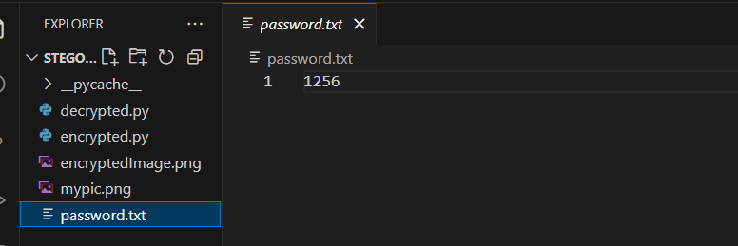
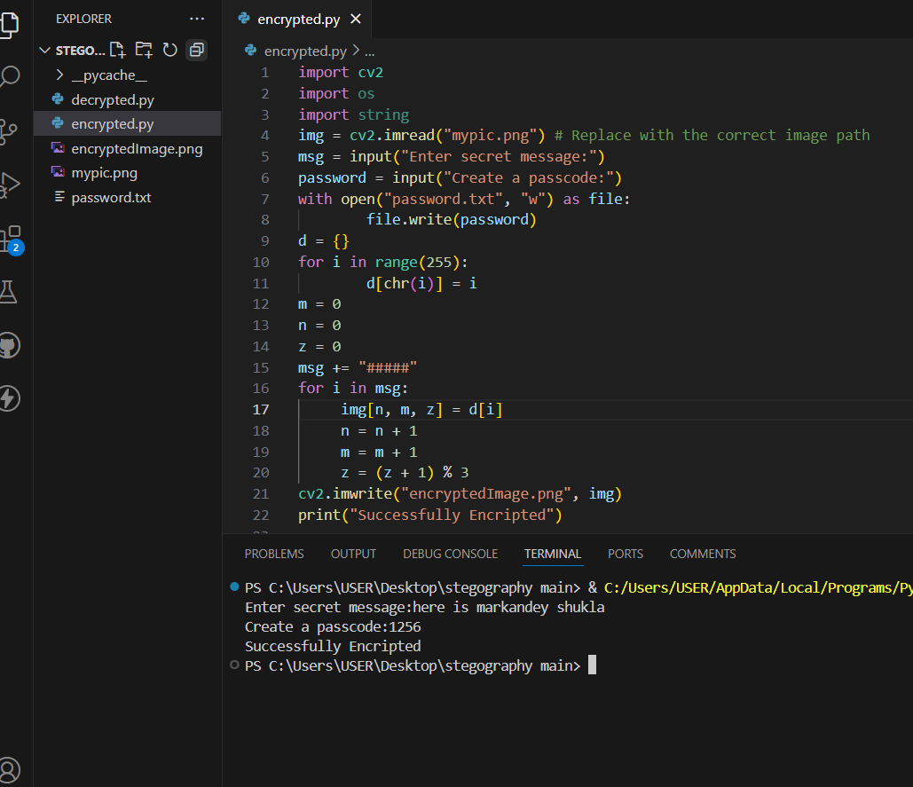
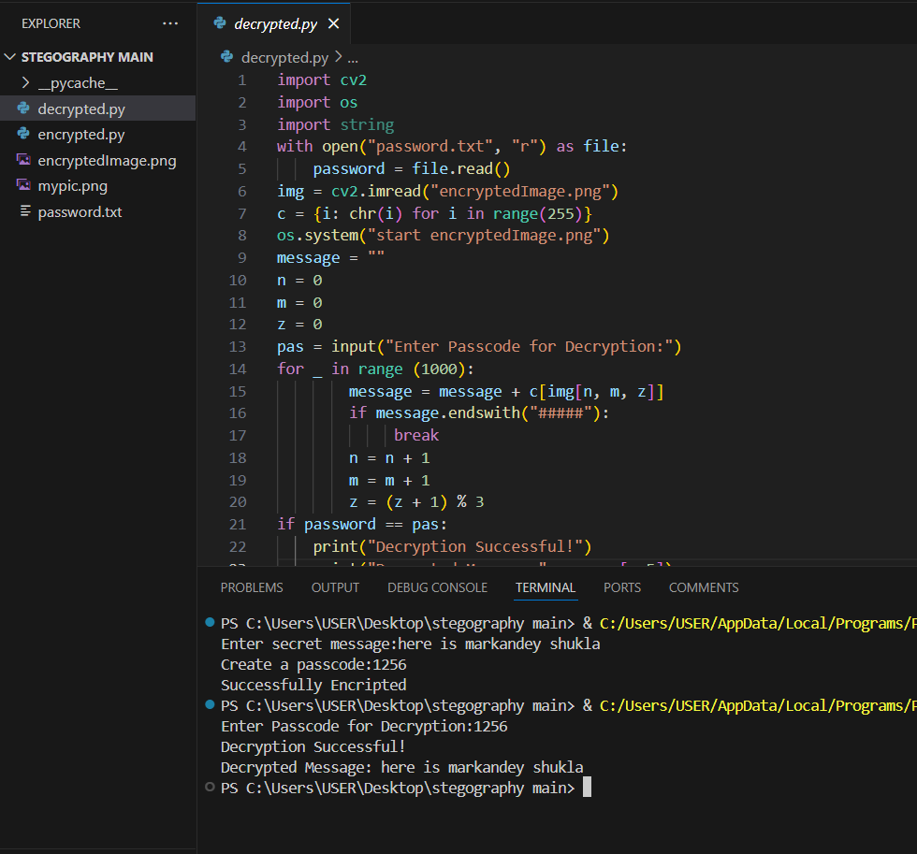
Results
Screenshots of the outcome (min 3)

Slide 8
Conclusion
This project successfully implements a secure steganographic encryption and decryption system. Initially, handling the password separately was a challenge, but storing it in a dedicated file resolved the issue. By embedding messages within images and securely managing passwords, the project ensures data confidentiality. The solution is user-friendly, efficient, and can be applied in various fields requiring secure communication.

Slide 9
GitHub Link
https://github.com/markandeyshukla/Steganography.git

Slide 10
Future scope(optional)

Slide 11
THANK YOU

